Slide 1


Http Module

Slide 2
List of content:
What is http ?
NodeJS http module

Slide 3
What is http ?
HTTP stands for Hypertext Transfer Protocol.
It is a protocol used for transmitting data over the internet. HTTP defines how clients and servers communicate with each other and how requests and responses should be formatted and transmitted. It is the foundation of data communication for the World Wide Web or the internet.

Slide 4
Http module in nodeJS
Node's http module is an integral component that facilitates various aspects of the HTTP protocol. To use the http module, start by creating a new file named "server.js" and then import the http module using the require() function
Second, create an HTTP server using the createServer() method of the http object.
Finally, the incoming HTTP request is monitored on port.

Slide 5
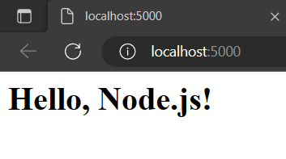
Example:

Slide 6
THANK YOU

